Slide 1


INTRODUCING MY SELF
GHAZANFAR

Slide 2

ABOUT ME
MY NAME : GHAZANFAR
I AM 16 YEARS OLD
I LIVE IN : KARACHI,PAKISTAN
I AM CURRENTLY STUDYING IN CLASS:11
STATUS : SINGLE

Slide 3
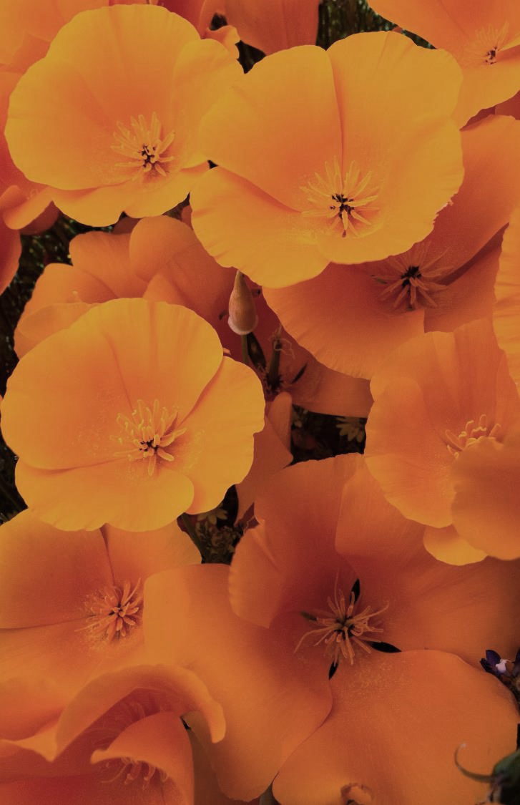
MY FAMILY
I LIVE WITH MY FAMILY
THERE ARE 3 MEMBERS IN MY FAMILY
MY FATHER MY MOTHER AND ME
MY FATHER IS WORKING IN PAKISTAN AIR FORCE FROM PAST 26 YEARS
MY MOTHER IS A TEACHER

Slide 4
MY EDUCATION
I STUDY AT MYSA PUBLIC COLLEGE
I ENJOY LEARNING NEW THINGS AND PRATICIPATING IN SCHOOL ACTIVITES
I ALSO LIKE GAMING AND SPORTS ETC. DURING MY FREE TIME
MY FAVORITE SUBJECTS ARE : ENGLISH, MATHS, COMPUTER

Slide 5
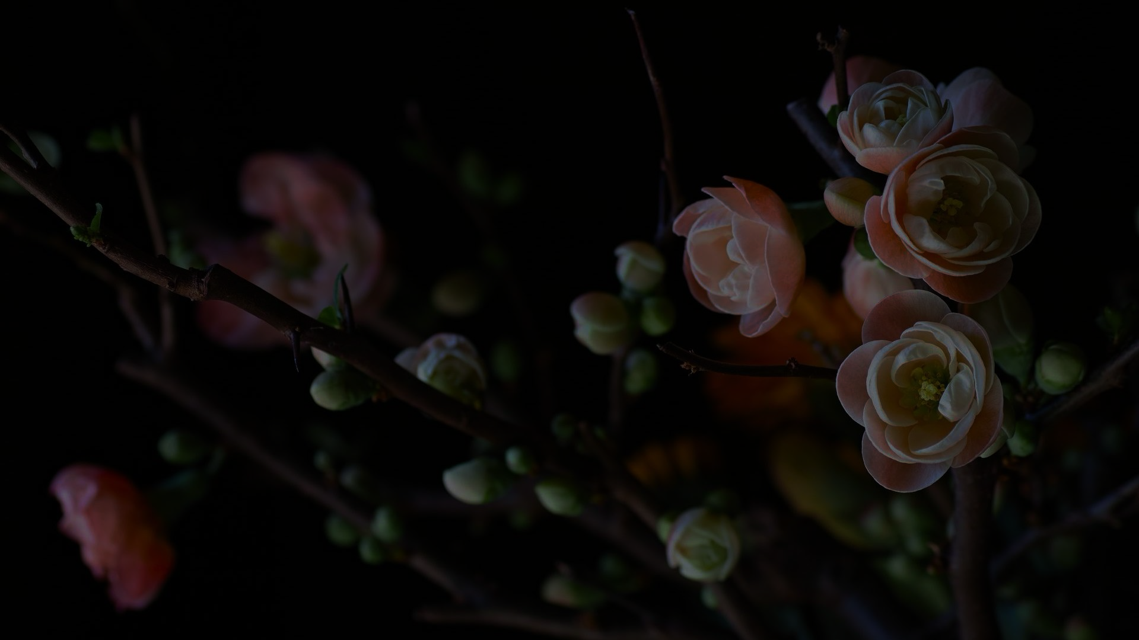
MY MERITS
n

Slide 6
PART 1
THERE ARE SOME OF MY GOOD QUALITES :
I AM HARD WORKING AND NEVER GIVE UP EASILY.
I ALWAYS TRY TO FINISH MY WORK ON TIME I LIKE TO HELP OTHER AND BE KIND I TRY TO HONEST IN EVERITHING I DO

Slide 7
MORE MERITS PART 2
I ENJOY LEARNING AND IMPROVING MY SELF EVERY DAY
I AM A GOOD LISTNER AND RESPECTS OTHER OPINIONS.
I STAY CALM EVEN IN DIFICULT SITUATIONS
I WORK WELL IN TEAMS AND ENJOY GROUP ACTIVITES
I LIKE TO TRAVEL ALONE AND EXPOLRE NATURE

Slide 8

MY DEMERITS
I SOMETIMES OVERTHNKS SMALL PROBLEM,
I GET DISTRACTED BY MY PHONE AND GAMES.
I AM STILL WORKING ON IMPROVING MY TIME MANGEMENTS.
I AM TRYING HARD TO TURN THESE WEAKNESSES INTO STRENTHGTHS

Slide 9
SELF IMPROVEMENTS
I BELIEVE NO ONE IS PERFECT, AND WE ALL CAN GROW
I AM LEARINING TO:
SPEAK MORE CONFIDENTLY
STAY FOCUSED ON MY STUDIES STAY POSITIVE EVEN THINGS ARE TOUGH

Slide 10

THANK YOU

